Slide 1
Protect Your Good name
Reduce Your Risk of Identity Thieves

Slide 2
Reduce Access to Personal Data
Shred credit card offers
Use a locked mailbox
Mail envelopes inside the post office
Remove listing from telephone directory

Slide 3

Internet and Security Safeguards
Install a firewall
Install and updates virus protection software
Never response to phishing email
Use credit, not debit. Cards when shopping

Slide 4
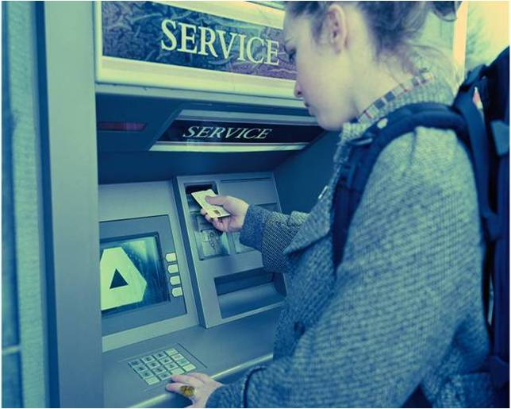
Beware of ‘Shoulder Surfers’
Shield your hand when entering your PIN
Thieves may be watching with binoculars

